Slide 1

TheAnalyticsTeam
Sprocket Central
Pty Ltd
Data analytics approach
Sanjay C S, Junior Consultant

Slide 2
Agenda
1. Introduction
2. Data Exploration
3. Model Development
4. Interpretation

Slide 3
Introduction
Identifying and Targeting High Value Customers
Outline of the problem
Sprocket Central Pty Ltd is a company that specializes in high-quality bike and cycling accessories.
By Analyzing the dataset provided, the marketing team is looking for ways to boost sales.
The aim of this analysis is to analyze the provided 3 datasets and target the new 1000 customers to drive higher value for the company.
Approach for Data Analysis
Age Distribution of New and Old Customers.
Past 3 years bike related purchases by different gender.
Industry contribution to bike related purchases in the past 3 years.
Wealth segmentation by age category.
Profits by Wealth Segments of different age groups and Industries.
Status of car ownership in each state.
Customer Classification based on RFM Analysis.

Slide 4
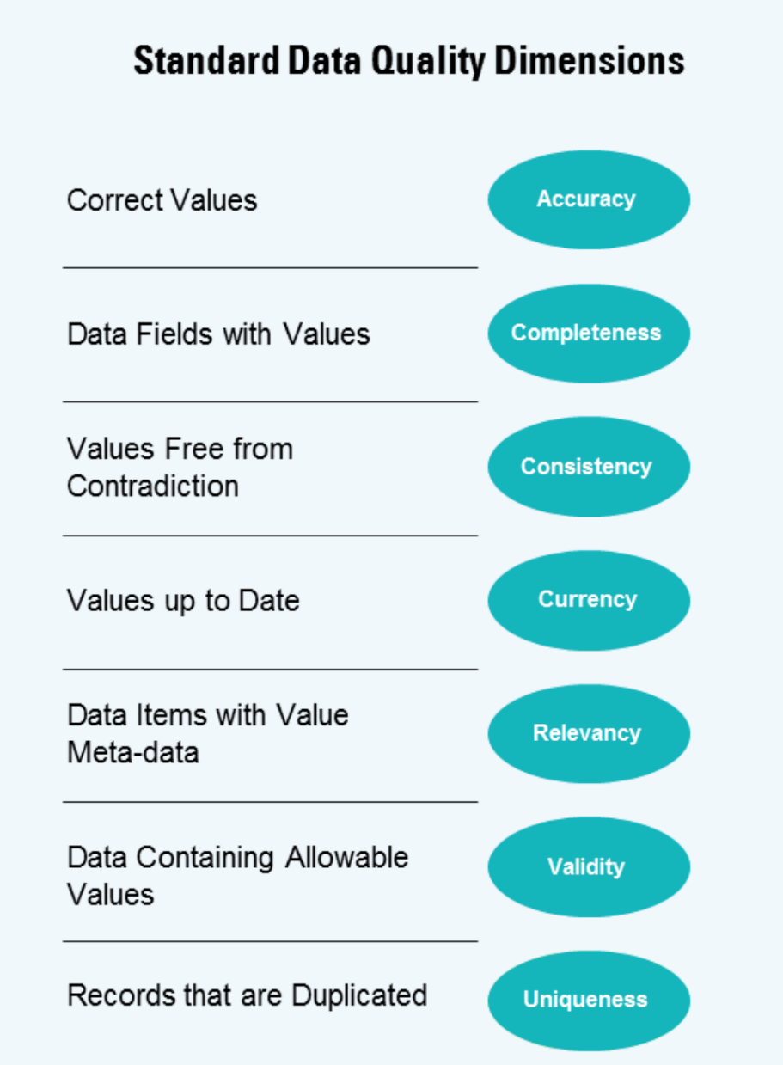
Data Exploration
Data Quality Assessment
Key issues for Data Quality Assessment
 | Accuracy | Completeness | Consistency | Relevancy | Validity
Customer Demographic | inaccurate DOB | Blanks in Job_title, DOB | Incosistency in gender column | default column is irrelevant
Customer Address |  | Incomplete Customer Ids | Inconsistency in State
Transactions |  | Incomplete Customer Ids, Columns online_order, brand, product_line, product_class, product_size, standard_cost and product_first_sold_date are empty. |  |  | product_first_sold_date is not in proper date format
New Customers |  |  |  |  | past_3_years_bike_related_purchases, column postcode and property_valuation are set as a Text column

Slide 5
Data Exploration
Age Distribution of New and Old Customers.
A majority of Old customers are aged between 40 to 50, the same is true with the New Customer List as well. This is followed by age group 50 to 60.
Lowest age groups are customers aged above 80+.
There’s a steep drop of no. of customers for the age group 50-60 in the Old Customers graph. Whereas for the new customers the steep drop is for age group 30-40.
The main age group to be focused for a better business is 20 to 70.

Slide 6
Data Exploration
Bike related purchases over the past
3 years by different gender across different Industries.
Old Customers
Majority of the bike related purchases were from the Manufacturing, Financial Services and Health Industries.
Females made more Bike related purchases than male.
IT, Agriculture and Telecommunication Industries have made the least bike related purchases.
A similar profile can be seen in case of new customers as well.
New Customers

Slide 7
Data Exploration
Wealth Segmentation by Age Cluster
Mass Customers are largest number of customers in any every age groups.
In many cases Affluent Customers outperform the High Net Worth Customers.

Slide 8
Data Exploration
Profits by Wealth Segments of
different age groups and Industries
Overall Mass Customers generate highest amount of profits.
Profit is more by customers aged 40 to 50.
The top 3 Industry Sectors that are generating highest profits are Manufacturing, Financial Services, and Health Industries.
These 3 Industries generate more than 2Million AU$, which accounts for 67% of total profit.
IT, Agriculture and Telecommunication Industries have generated the least amount of profit.

Slide 9
Data Exploration
Car Ownership Status in each State
New South wales has the highest number of people who do not own a car.
Queensland and Victoria have less number of car ownership compared to New South Wales.
But both Queensland and Victoria show potential marketplace to boost business.

Slide 10
Model Development
Scatter plot based off of RFM Analysis
More Revenue was generated by Customers who visited just a while ago.
Customers who recently visited (50 to 100 days) also generated a moderate amount of Revenue.
Customers who visited more than 200 days ago generated very less Revenue.

Slide 11
Model Development
Scatter plot based off of RFM Analysis
More Revenue was generated by Customers whose Frequency of purchase was more than 8.
Based on the graph it can be said that the relationship between Monetary Value and Frequency of Purchase is Positive for Business.

Slide 12
Model Development
Scatter plot based off of RFM Analysis
There’s a high possibility of customers visiting more frequently given they visited the site recently.
A Higher frequency is inversely related to the recency value.

Slide 13
Interpretation
Customer Targeting and Methodology
Platinum Customers are Very Loyal Customers who most frequently buys from us.
Gold Customers are Loyal Customers who most often buys from us and spends a large amount of money.
Silver Customers are those who are becoming Loyal Customers by buying more than once and spends fairly large amounts of money.
Bronze Customers are Recent Customers who bought recently and have spent average amount of money.

Slide 14
Interpretation
Customer Targeting and Methodology
Age group to be targeted mainly are those between 20 to 70 specifically 40 to 50.
Most of the High Value Customers will be Female compared to Male.
Customers to be targeted are those who are working in Manufacturing, Financial Services, and Health Industries.
Focus on Mass Customer Wealth Segment as they would be generating a very high amounts of profits.
A large number of population resides in New South Wales State, targeting them would boost Business significantly.

Slide 15
Interpretation
Customer Targeting and Methodology
An example of Potential Customers Based on the Analysis.
first_name | last_name | past_3_years_bike_related_purchases | Age | job_industry_category | wealth_segment
Melba | Spellacy | 38 | 46 | Health | Mass Customer
Martelle | Tuppeny | 52 | 42 | Manufacturing | Mass Customer
Patricia | Everix | 34 | 45 | Health | Mass Customer
Daryl | Pauncefort | 12 | 44 | Financial Services | Mass Customer
Sunny | Christescu | 90 | 48 | Financial Services | Mass Customer
Theresa | Cowper | 99 | 47 | Manufacturing | Mass Customer
Loleta | Aberdalgy | 45 | 42 | Health | Mass Customer
Alexina | Mabley | 72 | 48 | Manufacturing | Mass Customer
Katleen | Arnoult | 6 | 46 | Manufacturing | Mass Customer
Amabel |  | 71 | 42 | Financial Services | Mass Customer

Slide 16
Thank You

